Slide 1
CSS 497 2018 Capstone Neural Network parameter selection with Genetic Algorithms using Reinforcement Learning
Danny Ly
Advisor: Dong Si
Computer Science and Software Engineering

Slide 2

Motivation
UWB CSS Personal Statement and Artificial intelligence
Career Goals in Machine Learning

Slide 3
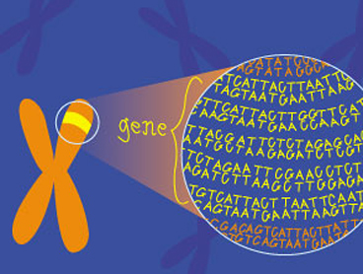
Purpose
Explore what ‘genetic algorithms’ meant
Apply their use to a practical real-world problem
Combing Neural Network’s, Reinforcement Learning, and Genetic Algorithms

Slide 4
Genetic Algorithms Natural Selection
A. Genetic Diversity
Initial Population
B. Evaluate Fitness
5 Rounds of Ping-Pong
E. Next Generation
Repeated Process
D. Reproduce
Breed & Mutate Survivors
C. Selection
Kill Unfit Networks

Slide 5
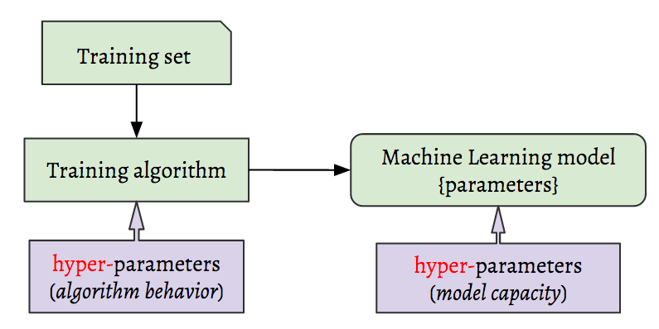
Hyper parameters
Configurations of a Neural Network
Complex networks can have millions
Number hidden neuron, Learning rate, Decay rate and weights

Slide 6
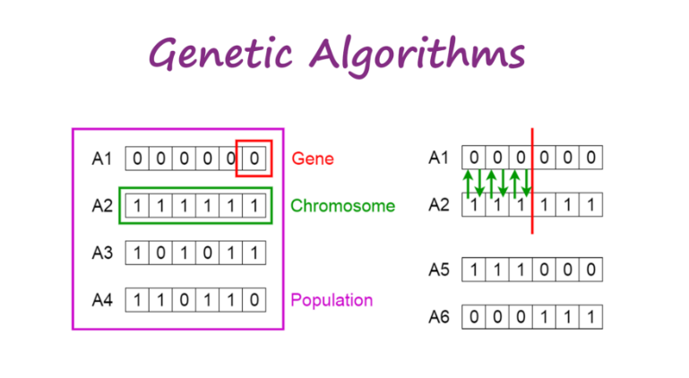
Genetic Algorithms?
Optimization method
Offspring will be better than parents
Mutations

Slide 7
Uses?
Complex problems: Lots of parameter combinations
No time constraint
Optimization problems

Slide 8
Policy Gradients(TO REMOVE)
Forward Policy
Backward Policy

Slide 9
Problem
Ping-Pong
Simple constraints: up, down, none
Reward based: good vs. bad behaviors

Slide 10
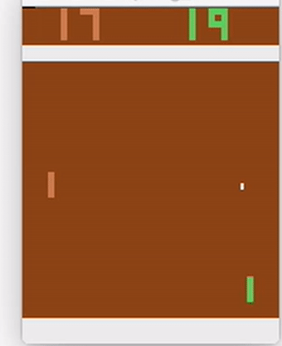
Goal
Using Genetic algorithms find the best hyper parameters that will allow this program to adequately play against another computer.

Slide 11
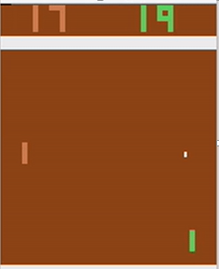
Design Approach
Pixels of the game board
Hidden Layer
Probability of Moving up, down, or not at all
Image Classification
Aims at turning on specific Neurons

Slide 12
Genetic Algorithm program flow
Initial Neural Network Population
Network Plays in their on environments
Pick Two top Performing Networks
Breed Top performers together
Combine Top Performers, their spawn, and mutated Networks into Population
Remove 50 % of population and the remaining Networks

Slide 13
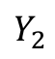
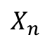
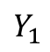
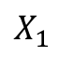
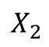
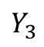
Neural Network Architecture
Input Layer
Hidden Layer
Output Layer
$$X_{1}$$
Σ
Σ
Σ
$$Y_{1}$$
$$X_{2}$$
Σ
Σ
Σ
$$Y_{2}$$
Network Outputs
Network inputs
Σ
$$Y_{3}$$
$$X_{n}$$
Σ
Σ
Neuron
Bias
1
1

Slide 14
Pre-Trial Results
Green is iteration 0
Model behavior, paddle stuck at top and bottom of screen

Slide 15
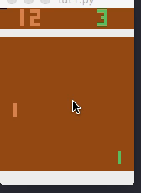
Post-Trial Result
Green is Trained Network
Adequate Performance and behavior

Slide 16

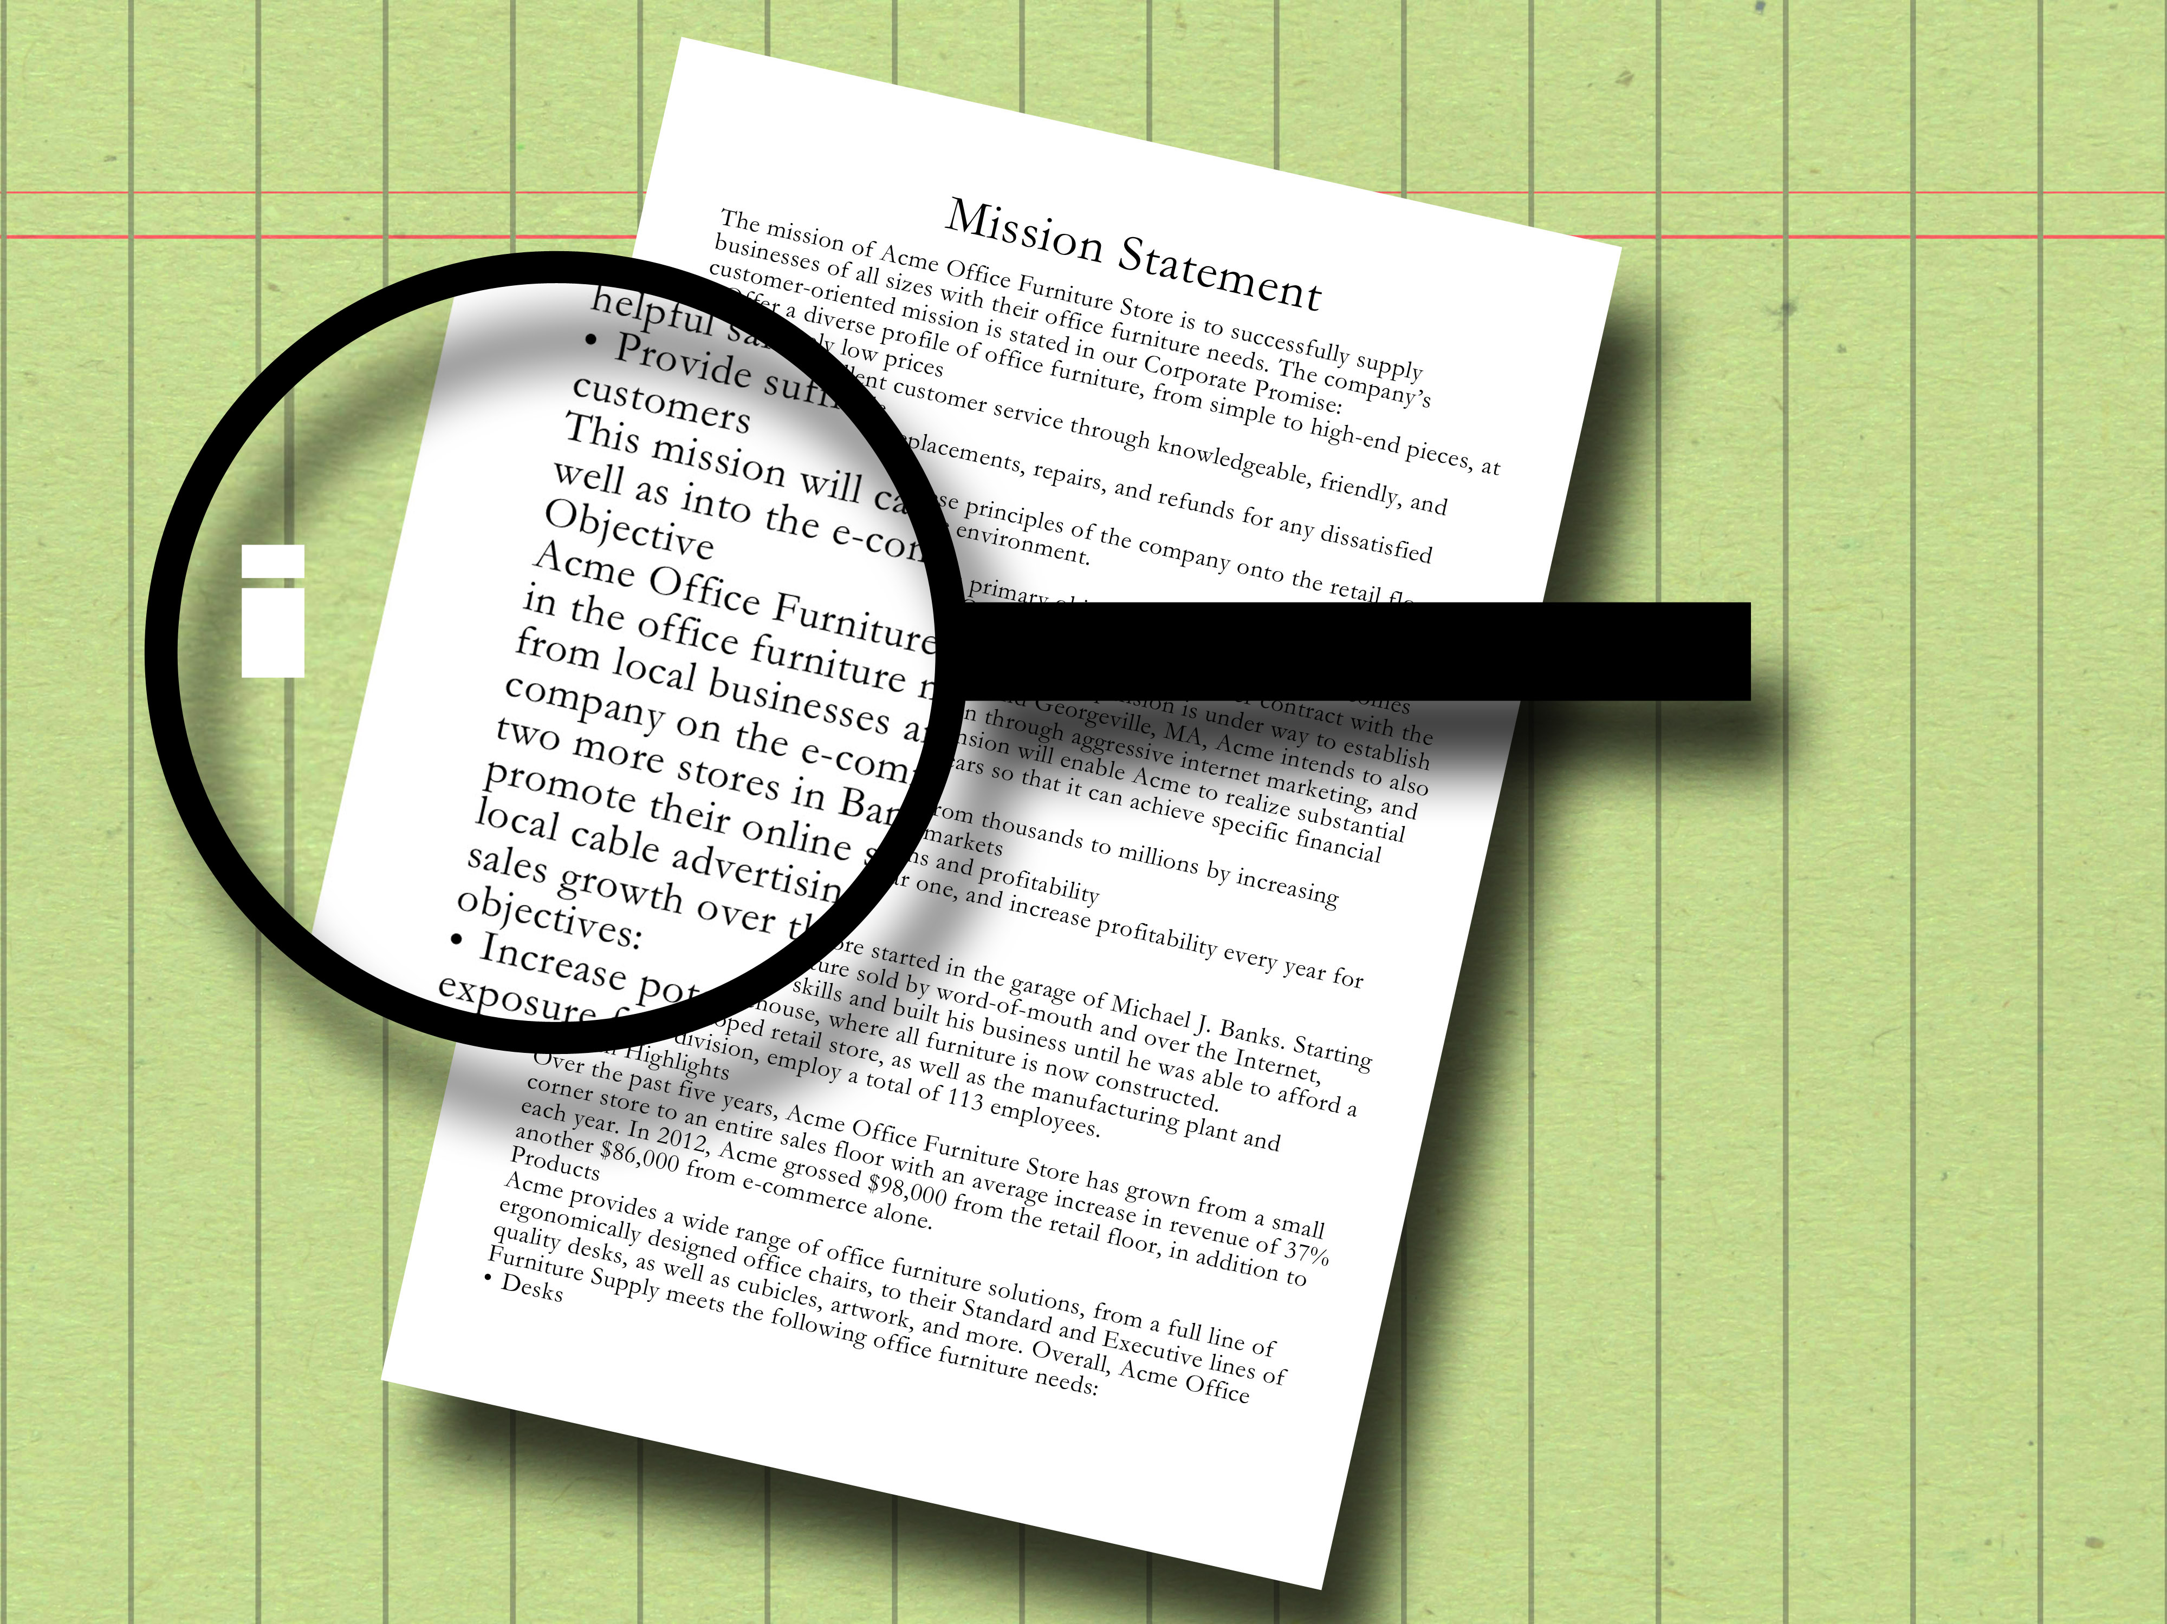
Summary
Genetic algorithms for parameter optimization
Good for complex problem multiple parameters
Bad for simple problems, slower performance
Natural selection process

Slide 17
Thank you
Questions?
References (KEEP????)
Géron, A. (2017). (Hands-On Machine Learning). Newton, MA; O'Reilly Media
Karpathy, A.(2016, May 31). Deep Reinforcement Learning. Retrieved from URL http://karpathy.github.io
Montana & Davis. (1989, Aug 25). Training feed forward using genetic algorithms). Retrieved from URL https://dl.acm.org

Slide 18
References
Géron, A. (2017). (Hands-On Machine Learning). Newton, MA; O'Reilly Media
Karpathy, A.(2016, May 31). Deep Reinforcement Learning. Retrieved from URL http://karpathy.github.io
Montana & Davis. (1989, Aug 25). Training feed forward using genetic algorithms). Retrieved from URL https://dl.acm.org
(Schultz, Grefenstette, Moriarty). (1999). Evolutionary Algorithms Reinforcement Learning. Retrieved from URL https://www.jair.org/
Mallawaarachchi, V. (2017). Genetic Algorithms. Retrived from URL https://towardsdatascience.com

Slide 19
Tools
Python
OpenAI Gym
GitHub
Docker
Digital Ocean
Numpy

